Slide 1

Dholakpur
Vishwa Vidyalaya
A story of Our Students

Slide 2

Demographics of
Our Students

Slide 3
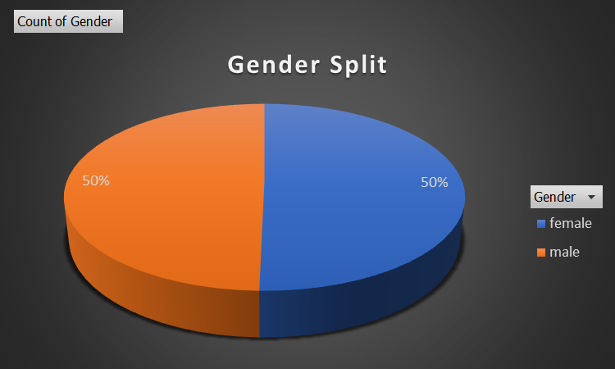
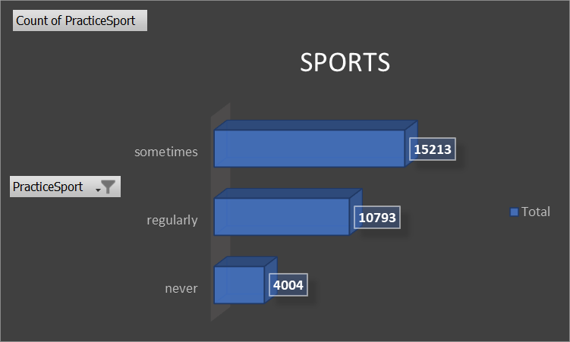
Gender Split and Sports

Slide 4
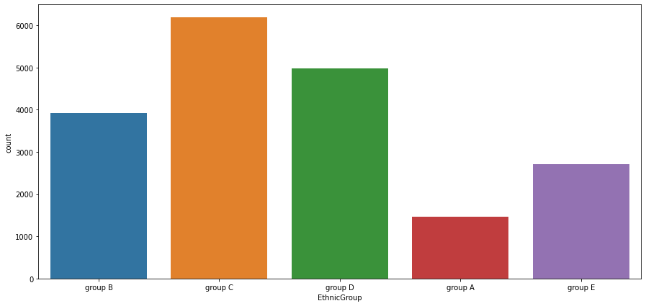
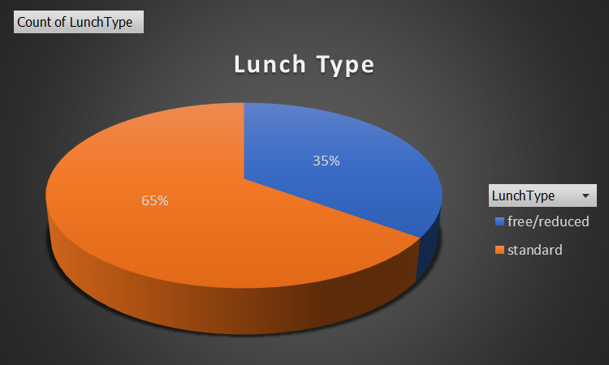
Ethnicity and Lunch Type

Slide 5
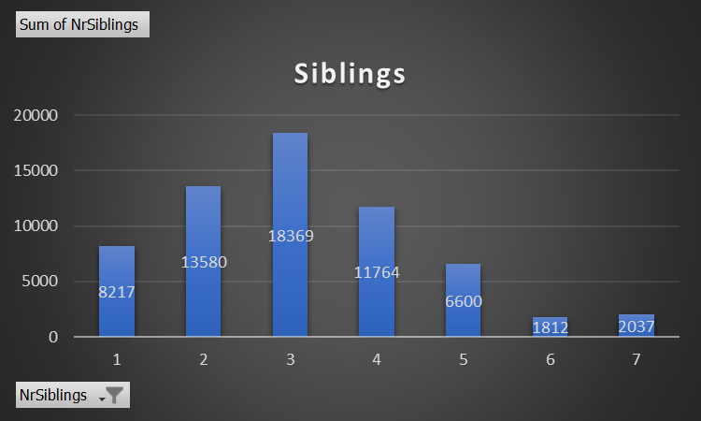
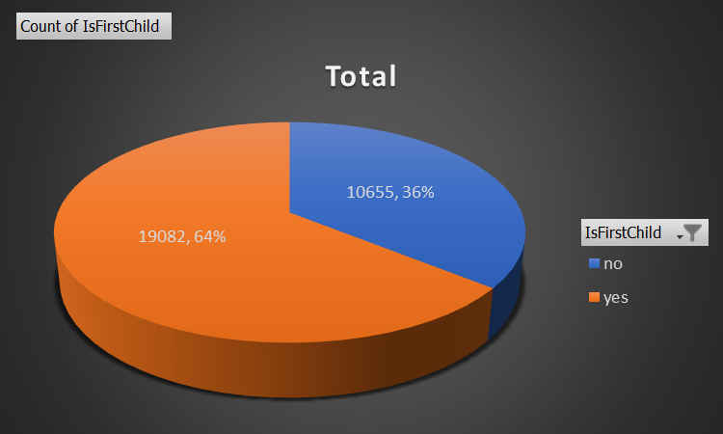
Family Background

Slide 6
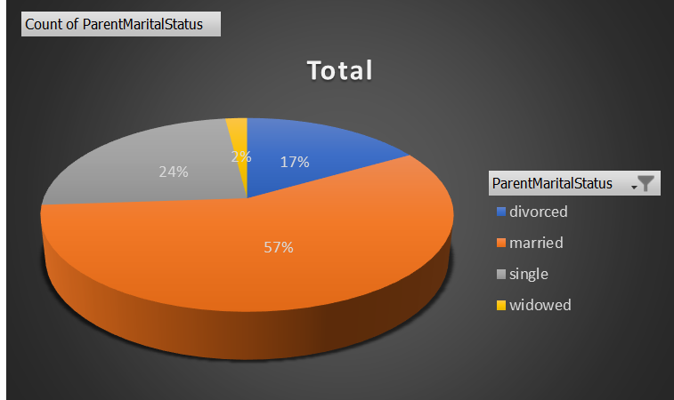
Parent Marital Status

Slide 7

Marks Distribution

Slide 8
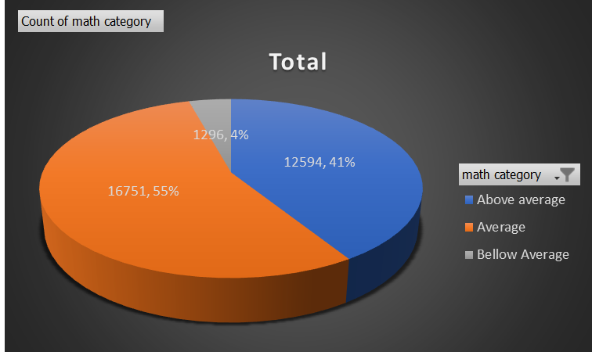
Maths Score

Slide 9
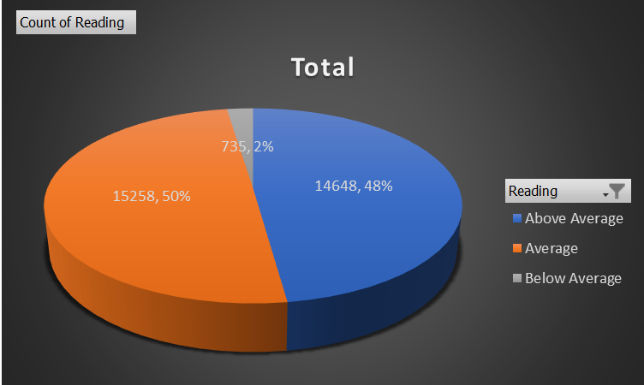
Reading Score

Slide 10
Writing Score

Slide 11
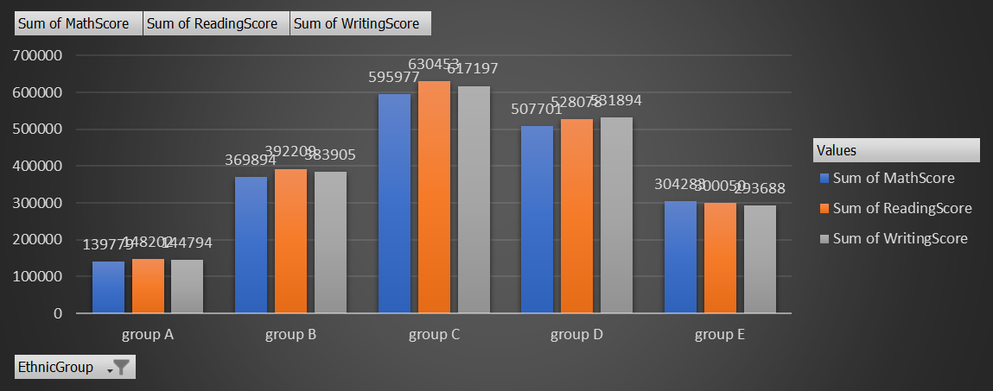
Scores of Students Based on Their Ethnic Group

Slide 12
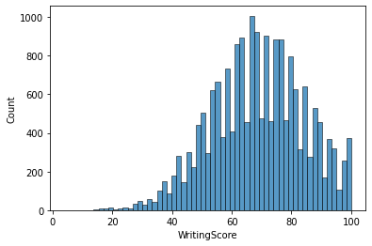
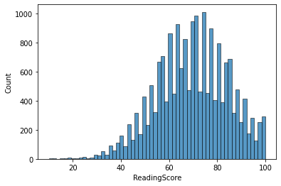
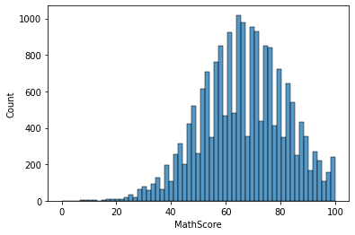
Histograms of Score

Slide 13
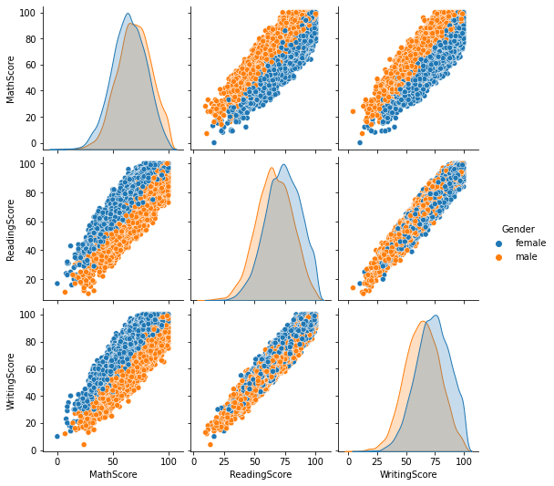
Marks of the
Students
based on thier
Gender Split

Slide 14
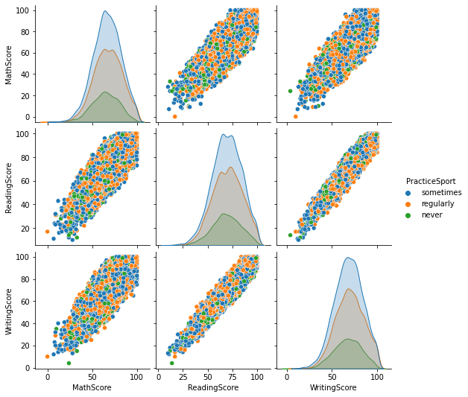
Marks of the
Students
based on thier
Sports Practice

Slide 15
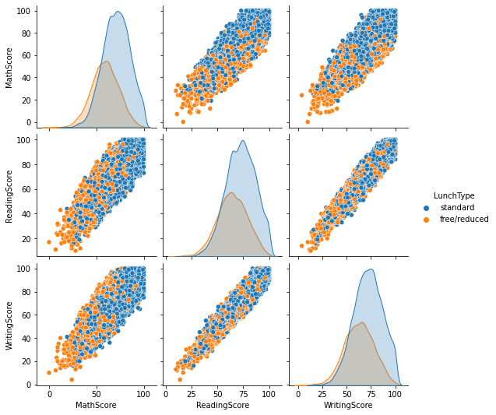
Marks of the
Students
based on thier
Eating habbit in the Lunch.

Slide 16
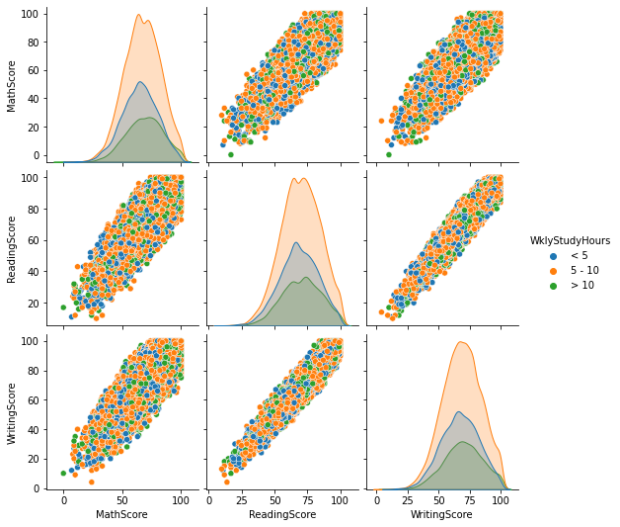
Marks of the
Students
based on thier
hours of Study

Slide 17
Why Do Students who Study more than 10 hours have less marks in their test?

Slide 18
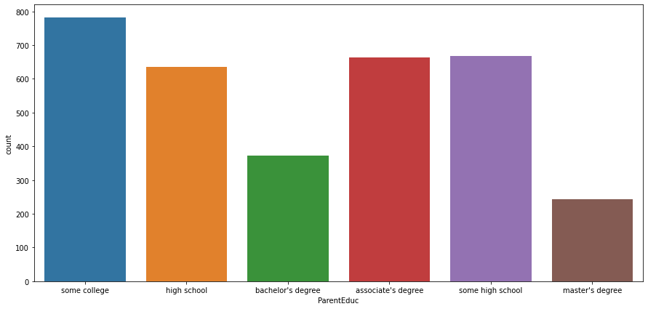
Parents Education Level

Slide 19
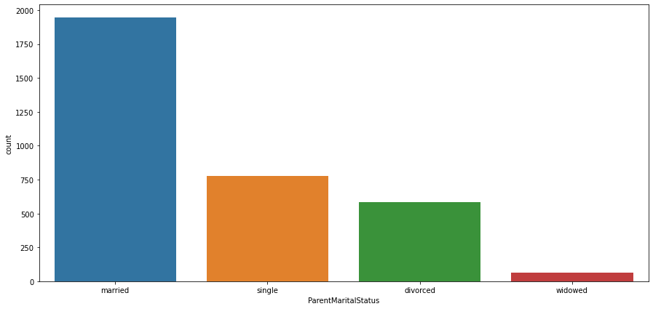
Parents Marital Status

Slide 20
Conclusion
So the Marks of the Stdents based on their Family Background, their Demography, their Eating Habitat(Directly proportional).
Students who study for more than 10 hours have less score as compared to the other, this is because of their Parent educational and Marital status.

Slide 21

Thank you!

